Slide 1

CSE221: Algorithms
Graphs
Prepared by: A B M Muntasir Rahman [MUNR]

Slide 2
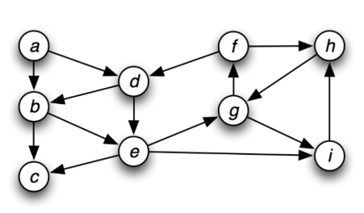
What is a Graph?
Graph G is pair (V, E) where V is a finite set (set of vertices) and E is a finite set of pairs from V (set of edges).
We generally denote n = |V| and m = |E|.
Here,
V = {a, b, …, i} and n = |V| = 9
E = {ab, bc, ad, …..} and m = |E| = 15

Slide 3
Applications of Graphs
Transportation Networks: How should you design the roads and highway network in a country? What is the quickest way to go from BRAC University to Mirpur?
Communication Networks: How to send network packet from your computer to your friend’s computer?
Social Networks: Facebook, Instagram, Twitter etc.
Dependency Networks: What courses you must take before you can take CSE470?

Slide 4
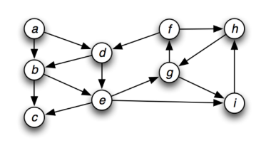
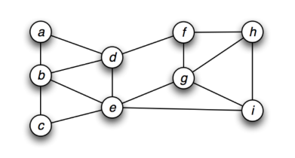
Directed vs Undirected Graphs
Graph G can be directed, if E consists of ordered pairs, or undirected, if E consists of unordered pairs.
If (u, v) Є E, then vertices u and v are adjacent.

Slide 5
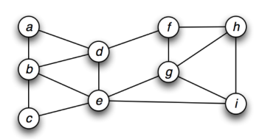
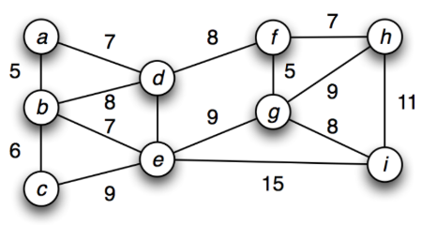
Weighted vs Unweighted Graphs
Weights can be assigned to the edges i.e. w_{G} (e) is a weight of the edge e Є E. Any graph that has such function assigned to it’s edges is called weighted graph.

Slide 6
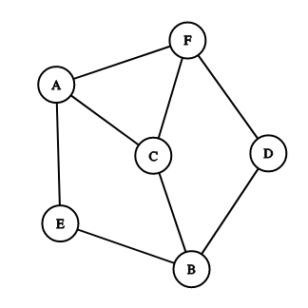
Basic Terminologies
Edges: Connections/Links between vertices (or nodes).
Here, AF, AC, BC etc. are edges of the graph.

Slide 7
Basic Terminologies
Incoming Edges: Directed edges coming into a vertex.
Here, AB and DB are two incoming edges of vertex B.

Slide 8
Basic Terminologies
Outgoing Edges: Directed edges going out of a vertex.
Here, BC and BE are two outgoing edges of vertex B.

Slide 9
Basic Terminologies
Degree: For an undirected graph, number of connected edges to a vertex v is called the degree of that vertex and is denoted by deg(v).
Vertex | deg(v)
a | 2
b | 4
c | 2
d | 4
e | 5

Slide 10
Basic Terminologies
In Degree: The number of incoming edges to a vertex v is called the in-degree of the vertex and is denoted by indeg(v).
Out Degree: The number of outgoing edges from a vertex v is called the out-degree and is denoted by outdeg(v).
Vertex | indeg(v) | outdeg(v)
a | 0 | 2
b | 2 | 2
c | 2 | 0
d | 2 | 2
e | 2 | 3

Slide 11
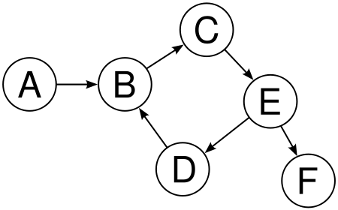
Basic Terminologies
Source Vertex: A vertex with in-degree zero. Generally, in a graph, at least one source vertex is present.
In the graph, vertex A is a source vertex.

Slide 12
Basic Terminologies
Sink Vertex: A vertex with out-degree zero.
In the graph, vertex F is a sink vertex.

Slide 13
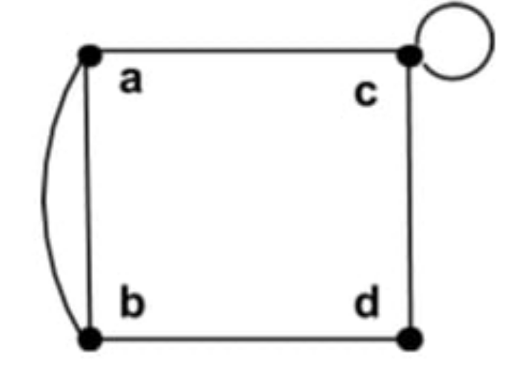
Basic Terminologies
Parallel Edges: Multiple edges between same pair of vertices.
In the graph, vertex a and b has two edges between each other i.e. they are parallel.

Slide 14
Basic Terminologies
Self Loop: An edge between the vertex and itself.
In the graph, vertex c has an edge which starts from c and ends at c i.e. a self loop.

Slide 15
Basic Terminologies
Path: A sequence of vertices connected by edge(s).
In the graph, path from A to D is (A -> B -> C -> E -> D).

Slide 16
Basic Terminologies
Cycle: A closed path where first and last vertices are the same.
In the graph, a path exists from B to B (B -> C -> E -> D -> B) which is a cycle.

Slide 17
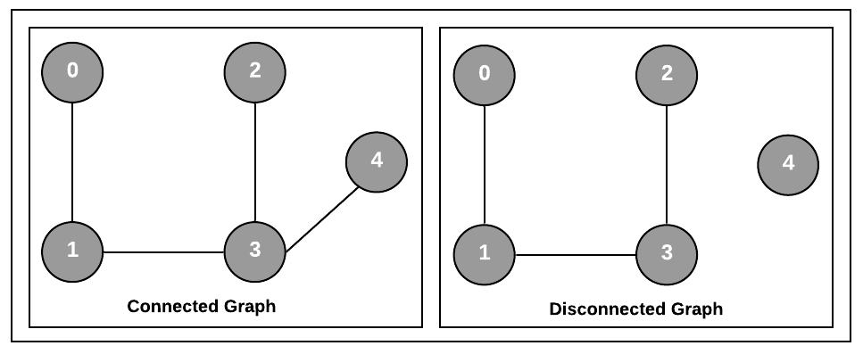
Basic Terminologies
Connected Graph: A path exists between every pair of vertices.

Slide 18
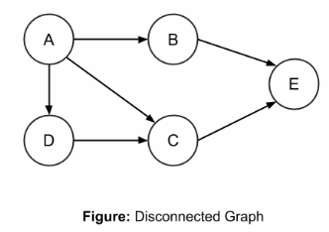
Basic Terminologies
Disconnected Graph: A path is absent between any pair of vertices.

Slide 19
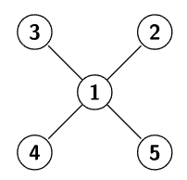
Basic Terminologies
Sparse Graph: Number of edges is considerably less than maximum number of edges.

Slide 20
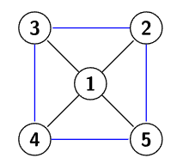
Basic Terminologies
Dense Graph: Number of edges is close to the maximum number of edges.

Slide 21
Relationship between n and m
If G is a graph with m edges, then Σdeg(v) = 2m
If G is a directed graph with m edges, then Σindeg(v) = Σoutdeg(v) = m
If G is a simple undirected graph with n vertices and m edges, then m ≤ n(n - 1)/2.
If G is a simple directed graph with n vertices and m edges, then m ≤ n(n - 1).

Slide 22
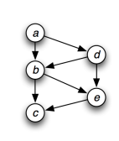
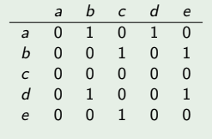
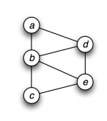
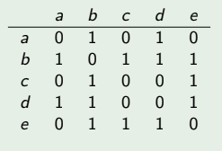
Representation of Graphs
Adjacency Matrix:
A graph G = (V, E) can be represented in an matrix of size n х n.
If (v_{i}, v_{j}) Є E, then a_{i, j} = 1 and 0 otherwise. In case of undirected graph, a_{i, j} = 1 and also a_{j, i} = 1.
Memory complexity is O(n²)
Directed Graph
Undirected Graph

Slide 23
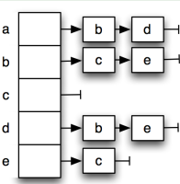
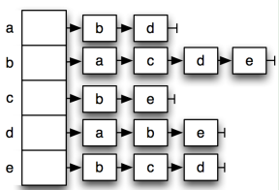
Representation of Graphs
Adjacency List:
Represents the graph by listing for each vertex v_{i}, it’s outgoing/connected vertices in a list out(v_{i}). (Can be represented using a Linked List or any other appropriate data structure)
Memory complexity is O(m + n)
Directed Graph
Undirected Graph

Slide 24
Graph Traversal
Given a graph G = (V, E), and a source vertex s, we want to visit all the vertices Є V exactly once!
Two graph traversal algorithms: Breadth First Search (BFS) and Depth First Search (DFS)

Slide 25
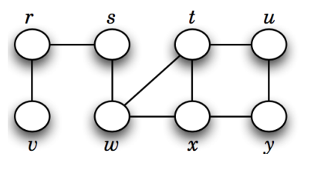
Breadth First Search (BFS)
Traverses the entire graph level-wise.
Uses Queue for traversal.
If we start from source vertex s,
then first level vertices are r, w
second level vertices are v, t, x
third level vertices are u, y
So, BFS traversal order will be,
s, r, w, v, t, x, u, y

Slide 26
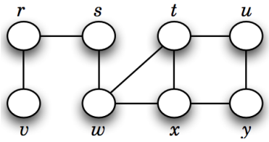
Simulation
Visited
0 | 0 | 0 | 0 | 0 | 0 | 0 | 0
r s t u v w x y
Distance
0 | 0 | 0 | 0 | 0 | 0 | 0 | 0
r s t u v w x y
Parent
N | N | N | N | N | N | N | N
r s t u v w x y

Slide 27
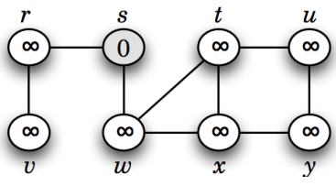

Simulation
Visited
0 | 1 | 0 | 0 | 0 | 0 | 0 | 0
r s t u v w x y
Distance
0 | 0 | 0 | 0 | 0 | 0 | 0 | 0
r s t u v w x y
Parent
N | -1 | N | N | N | N | N | N
r s t u v w x y

Slide 28
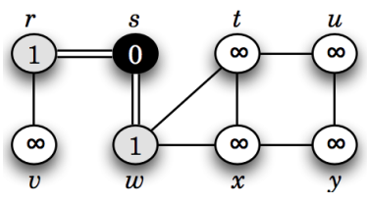

Simulation
Visited
1 | 1 | 0 | 0 | 0 | 1 | 0 | 0
r s t u v w x y
Distance
1 | 0 | 0 | 0 | 0 | 1 | 0 | 0
r s t u v w x y
Parent
s | -1 | N | N | N | s | N | N
r s t u v w x y

Slide 29
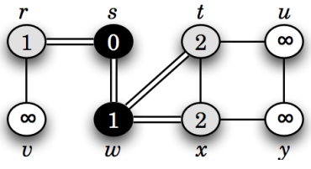

Simulation
Visited
1 | 1 | 1 | 0 | 0 | 1 | 1 | 0
r s t u v w x y
Distance
1 | 0 | 2 | 0 | 0 | 1 | 2 | 0
r s t u v w x y
Parent
s | -1 | w | N | N | s | w | N
r s t u v w x y

Slide 30
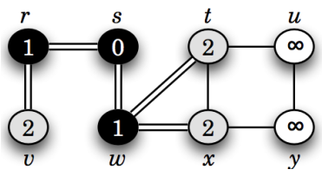

Simulation
Visited
1 | 1 | 1 | 0 | 1 | 1 | 1 | 0
r s t u v w x y
Distance
1 | 0 | 2 | 0 | 2 | 1 | 2 | 0
r s t u v w x y
Parent
s | -1 | w | N | r | s | w | N
r s t u v w x y

Slide 31
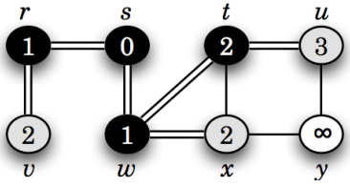

Simulation
Visited
1 | 1 | 1 | 1 | 1 | 1 | 1 | 0
r s t u v w x y
Distance
1 | 0 | 2 | 3 | 2 | 1 | 2 | 0
r s t u v w x y
Parent
s | -1 | w | t | r | s | w | N
r s t u v w x y

Slide 32
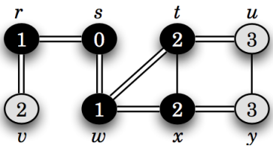

Simulation
Visited
1 | 1 | 1 | 1 | 1 | 1 | 1 | 1
r s t u v w x y
Distance
1 | 0 | 2 | 3 | 2 | 1 | 2 | 3
r s t u v w x y
Parent
s | -1 | w | t | r | s | w | x
r s t u v w x y

Slide 33
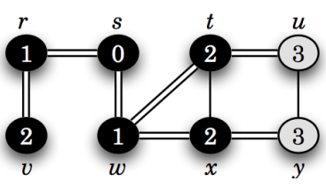

Simulation
Visited
1 | 1 | 1 | 1 | 1 | 1 | 1 | 1
r s t u v w x y
Distance
1 | 0 | 2 | 3 | 2 | 1 | 2 | 3
r s t u v w x y
Parent
s | -1 | w | t | r | s | w | x
r s t u v w x y

Slide 34
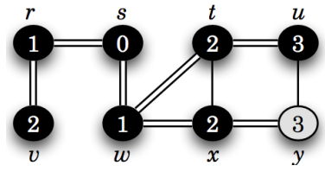

Simulation
Visited
1 | 1 | 1 | 1 | 1 | 1 | 1 | 1
r s t u v w x y
Distance
1 | 0 | 2 | 3 | 2 | 1 | 2 | 3
r s t u v w x y
Parent
s | -1 | w | t | r | s | w | x
r s t u v w x y

Slide 35
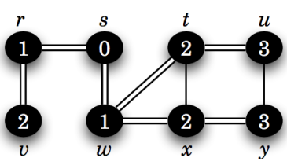

Simulation
Visited
1 | 1 | 1 | 1 | 1 | 1 | 1 | 1
r s t u v w x y
Distance
1 | 0 | 2 | 3 | 2 | 1 | 2 | 3
r s t u v w x y
Parent
s | -1 | w | t | r | s | w | x
r s t u v w x y

Slide 36
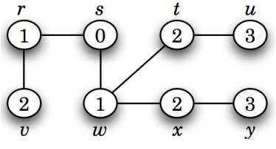
Simulation
BFS traversal sequence will be,
s, r, w, v, t, x, u, y

Slide 37
Simulation
Visited
What is the shortest distance between s to u?
Ans: Go to index u of distance array (3)
What is the shortest path from s to u?
Ans: Go to index u of parent array (t). Since t is not source, go to index t (w). w is not the source, so go to index w (s). Since s is source,
path will be s -> w -> t -> u.
1 | 1 | 1 | 1 | 1 | 1 | 1 | 1
r s t u v w x y
Distance
1 | 0 | 2 | 3 | 2 | 1 | 2 | 3
r s t u v w x y
Parent
s | -1 | w | t | r | s | w | x
r s t u v w x y

Slide 38
BFS Pseudocode
BFS(G, s)
Q = [], visited = [], parent = [], distance = []
visited[s] = 1, parent[s] = -1, distance[s] = 0
ENQUEUE(Q, s)
while Q is not empty
u = DEQUEUE(Q) //Dequeued sequence is the BFS sequence
for each vertex v Є Adj[u]
if visited[v] = 0
visited[v] = 1
distance[v] = distance[u] + 1
parent[v] = u
ENQUEUE(Q, v)

Slide 39
BFS Properties
Can find the shortest path and minimum distance required to traverse from a source vertex to all other vertices in an unweighted graph.
Can always find the solution.
In case of directed graph, not all vertices may be explored.
Not suitable for detecting cycles in a graph.
Time Complexity: O(n + m)
Space Complexity: O(n + m)

Slide 40
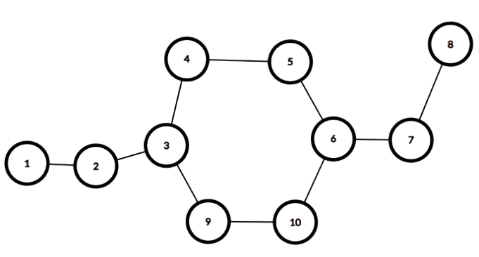
Bipartite/Bicolorable Graph
A graph that can be colored using exactly two colors
However, no two adjacent vertices should have the same color
G
G
B
Let’s assume two colors, B -> Blue
G -> Green
B
G
B
G
B
even cycle
G
B

Slide 41
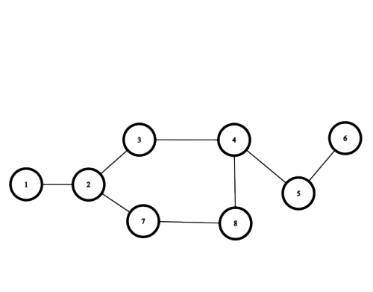
Bipartite/Bicolorable Graph
B
G
G
B
G
odd cycle
B
B
G
This is not bipartite graph!

Slide 42
Bipartite Graph Detection
Therefore, it can be said that, any graph that has
Odd Cycle -> is not a bipartite graph
Even Cycle -> is a bipartite graph
Similarly,
Bipartite Graph -> means it has even cycle
Non Bipartite Graph -> means it has odd cycle

Slide 43
Bipartite Graph Detection using BFS
Bipartite(G, s)
Q = [], visited = [], color = []
visited[s] = 1, color[s] = "B"
ENQUEUE(Q, s)
while Q is not empty
u = DEQUEUE(Q)
for each vertex v Є Adj[u]
if visited[v] = 0 then visited[v] = 1
if color[u] == "B" then color[v] = "G"
else color[v] = "B"
ENQUEUE(Q, v)
else if color[u] == color[v] return False
return True

Slide 44
Depth First Search (DFS)
Traverses the entire graph depth wise without regard for which edge it takes next until it can not go any further at which point it backtracks and continues.
Uses Stack for traversal.
If we start from source vertex s,
we can go to w, then to x, then to y, then u, then t. After that, we can backtrack from t to u, u to y, y to x, x to w and then to s. From s we can go deeper to r and then to v.
So, one DFS sequence will be,
s, w, x, y, u, t, r, v

Slide 45
Simulation
Visited
r
s
t
u
0 | 0 | 0 | 0 | 0 | 0 | 0 | 0
r s t u v w x y
Start Time
v
w
x
y
0 | 0 | 0 | 0 | 0 | 0 | 0 | 0
r s t u v w x y
End Time
0 | 0 | 0 | 0 | 0 | 0 | 0 | 0
Stack
r s t u v w x y

Slide 46
Simulation
Visited
r
s
u
s
t
0 | 1 | 0 | 0 | 0 | 0 | 0 | 0
r s t u v w x y
Start Time
v
w
x
y
0 | 1 | 0 | 0 | 0 | 0 | 0 | 0
r s t u v w x y
s
End Time
0 | 0 | 0 | 0 | 0 | 0 | 0 | 0
Stack
r s t u v w x y

Slide 47
Simulation
Visited
r
s
u
s
t
0 | 1 | 0 | 0 | 0 | 0 | 0 | 0
r s t u v w x y
Start Time
v
w
x
y
0 | 1 | 0 | 0 | 0 | 0 | 0 | 0
r s t u v w x y
s
End Time
0 | 0 | 0 | 0 | 0 | 0 | 0 | 0
Stack
r s t u v w x y

Slide 48
Simulation
Visited
r
u
r
s
s
t
1 | 1 | 0 | 0 | 0 | 0 | 0 | 0
r s t u v w x y
Start Time
v
w
x
y
2 | 1 | 0 | 0 | 0 | 0 | 0 | 0
r s t u v w x y
s r
End Time
0 | 0 | 0 | 0 | 0 | 0 | 0 | 0
Stack
r s t u v w x y

Slide 49
Simulation
Visited
r
u
r
s
s
t
1 | 1 | 0 | 0 | 0 | 0 | 0 | 0
r s t u v w x y
Start Time
v
w
x
y
2 | 1 | 0 | 0 | 0 | 0 | 0 | 0
r s t u v w x y
s r
End Time
0 | 0 | 0 | 0 | 0 | 0 | 0 | 0
Stack
r s t u v w x y

Slide 50
Simulation
Visited
r
u
r
s
s
t
1 | 1 | 0 | 0 | 1 | 0 | 0 | 0
r s t u v w x y
Start Time
v
v
w
x
y
2 | 1 | 0 | 0 | 3 | 0 | 0 | 0
r s t u v w x y
s r v
End Time
0 | 0 | 0 | 0 | 0 | 0 | 0 | 0
Stack
r s t u v w x y

Slide 51
Simulation
Visited
r
u
r
s
s
t
1 | 1 | 0 | 0 | 1 | 0 | 0 | 0
r s t u v w x y
Start Time
v
v
w
x
y
2 | 1 | 0 | 0 | 3 | 0 | 0 | 0
r s t u v w x y
s r
End Time
0 | 0 | 0 | 0 | 4 | 0 | 0 | 0
Stack
r s t u v w x y

Slide 52
Simulation
Visited
r
u
r
s
s
t
1 | 1 | 0 | 0 | 1 | 0 | 0 | 0
r s t u v w x y
Start Time
v
v
w
x
y
2 | 1 | 0 | 0 | 3 | 0 | 0 | 0
r s t u v w x y
s
End Time
5 | 0 | 0 | 0 | 4 | 0 | 0 | 0
Stack
r s t u v w x y

Slide 53
Simulation
Visited
r
u
r
s
s
t
1 | 1 | 0 | 0 | 1 | 0 | 0 | 0
r s t u v w x y
Start Time
v
v
w
x
y
2 | 1 | 0 | 0 | 3 | 0 | 0 | 0
r s t u v w x y
s
End Time
5 | 0 | 0 | 0 | 4 | 0 | 0 | 0
Stack
r s t u v w x y

Slide 54
Simulation
Visited
r
u
r
s
s
t
1 | 1 | 0 | 0 | 1 | 1 | 0 | 0
r s t u v w x y
Start Time
v
v
w
w
x
y
2 | 1 | 0 | 0 | 3 | 6 | 0 | 0
r s t u v w x y
s w
End Time
5 | 0 | 0 | 0 | 4 | 0 | 0 | 0
Stack
r s t u v w x y

Slide 55
Simulation
Visited
r
u
r
s
s
t
1 | 1 | 0 | 0 | 1 | 1 | 0 | 0
r s t u v w x y
Start Time
v
v
w
w
x
y
2 | 1 | 0 | 0 | 3 | 6 | 0 | 0
r s t u v w x y
s w
End Time
5 | 0 | 0 | 0 | 4 | 0 | 0 | 0
Stack
r s t u v w x y

Slide 56
Simulation
Visited
r
u
r
s
s
t
1 | 1 | 0 | 0 | 1 | 1 | 1 | 0
r s t u v w x y
Start Time
v
v
w
w
x
x
y
2 | 1 | 0 | 0 | 3 | 6 | 7 | 0
r s t u v w x y
s w x
End Time
5 | 0 | 0 | 0 | 4 | 0 | 0 | 0
Stack
r s t u v w x y

Slide 57
Simulation
Visited
r
u
r
s
s
t
1 | 1 | 0 | 0 | 1 | 1 | 1 | 0
r s t u v w x y
Start Time
v
v
w
w
x
x
y
2 | 1 | 0 | 0 | 3 | 6 | 7 | 0
r s t u v w x y
s w x
End Time
5 | 0 | 0 | 0 | 4 | 0 | 0 | 0
Stack
r s t u v w x y

Slide 58
Simulation
Visited
r
u
r
s
s
t
1 | 1 | 0 | 0 | 1 | 1 | 1 | 1
r s t u v w x y
Start Time
v
v
w
w
x
x
y
y
2 | 1 | 0 | 0 | 3 | 6 | 7 | 8
r s t u v w x y
s w x y
End Time
5 | 0 | 0 | 0 | 4 | 0 | 0 | 0
Stack
r s t u v w x y

Slide 59
Simulation
Visited
r
u
r
s
s
t
1 | 1 | 0 | 0 | 1 | 1 | 1 | 1
r s t u v w x y
Start Time
v
v
w
w
x
x
y
y
2 | 1 | 0 | 0 | 3 | 6 | 7 | 8
r s t u v w x y
s w x y
End Time
5 | 0 | 0 | 0 | 4 | 0 | 0 | 0
Stack
r s t u v w x y

Slide 60
Simulation
Visited
u
r
u
r
s
s
t
1 | 1 | 0 | 1 | 1 | 1 | 1 | 1
r s t u v w x y
Start Time
v
v
w
w
x
x
y
y
2 | 1 | 0 | 9 | 3 | 6 | 7 | 8
r s t u v w x y
s w x y u
End Time
5 | 0 | 0 | 0 | 4 | 0 | 0 | 0
Stack
r s t u v w x y

Slide 61
Simulation
Visited
u
r
u
r
s
s
t
1 | 1 | 0 | 1 | 1 | 1 | 1 | 1
r s t u v w x y
Start Time
v
v
w
w
x
x
y
y
2 | 1 | 0 | 9 | 3 | 6 | 7 | 8
r s t u v w x y
s w x y u
End Time
5 | 0 | 0 | 0 | 4 | 0 | 0 | 0
Stack
r s t u v w x y

Slide 62
Simulation
Visited
u
r
u
r
s
s
t
t
1 | 1 | 1 | 1 | 1 | 1 | 1 | 1
r s t u v w x y
Start Time
v
v
w
w
x
x
y
y
2 | 1 | 9 | 9 | 3 | 6 | 7 | 8
r s t u v w x y
s w x y u t
End Time
5 | 0 | 0 | 0 | 4 | 0 | 0 | 0
Stack
r s t u v w x y

Slide 63
Simulation
Visited
u
r
u
r
s
s
t
t
1 | 1 | 1 | 1 | 1 | 1 | 1 | 1
r s t u v w x y
Start Time
v
v
w
w
x
x
y
y
2 | 1 | 9 | 9 | 3 | 6 | 7 | 8
r s t u v w x y
s w x y u t
End Time
5 | 0 | 0 | 0 | 4 | 0 | 0 | 0
Stack
r s t u v w x y

Slide 64
Simulation
Visited
u
r
u
r
s
s
t
t
1 | 1 | 1 | 1 | 1 | 1 | 1 | 1
r s t u v w x y
Start Time
v
v
w
w
x
x
y
y
2 | 1 | 10 | 9 | 3 | 6 | 7 | 8
r s t u v w x y
s w x y u
End Time
5 | 0 | 11 | 0 | 4 | 0 | 0 | 0
Stack
r s t u v w x y

Slide 65
Simulation
Visited
u
r
u
r
s
s
t
t
1 | 1 | 1 | 1 | 1 | 1 | 1 | 1
r s t u v w x y
Start Time
v
v
w
w
x
x
y
y
2 | 1 | 10 | 9 | 3 | 6 | 7 | 8
r s t u v w x y
s w x y
End Time
5 | 0 | 11 | 12 | 4 | 0 | 0 | 0
Stack
r s t u v w x y

Slide 66
Simulation
Visited
u
r
u
r
s
s
t
t
1 | 1 | 1 | 1 | 1 | 1 | 1 | 1
r s t u v w x y
Start Time
v
v
w
w
x
x
y
y
2 | 1 | 10 | 9 | 3 | 6 | 7 | 8
r s t u v w x y
s w x
End Time
5 | 0 | 11 | 12 | 4 | 0 | 0 | 13
Stack
r s t u v w x y

Slide 67
Simulation
Visited
u
r
u
r
s
s
t
t
1 | 1 | 1 | 1 | 1 | 1 | 1 | 1
r s t u v w x y
Start Time
v
v
w
w
x
x
y
y
2 | 1 | 10 | 9 | 3 | 6 | 7 | 8
r s t u v w x y
s w
End Time
5 | 0 | 11 | 12 | 4 | 0 | 14 | 13
Stack
r s t u v w x y

Slide 68
Simulation
Visited
u
r
u
r
s
s
t
t
1 | 1 | 1 | 1 | 1 | 1 | 1 | 1
r s t u v w x y
Start Time
v
v
w
w
x
x
y
y
2 | 1 | 10 | 9 | 3 | 6 | 7 | 8
r s t u v w x y
s
End Time
5 | 0 | 11 | 12 | 4 | 15 | 14 | 13
Stack
r s t u v w x y

Slide 69
Simulation
Visited
u
r
u
r
s
s
t
t
1 | 1 | 1 | 1 | 1 | 1 | 1 | 1
r s t u v w x y
Start Time
v
v
w
w
x
x
y
y
2 | 1 | 10 | 9 | 3 | 6 | 7 | 8
r s t u v w x y
End Time
Stack
5 | 16 | 11 | 12 | 4 | 15 | 14 | 13
Since stack is empty, DFS has traversed all vertices!
r s t u v w x y

Slide 70
Simulation
u
r
u
r
s
s
t
t
DFS traversal sequence will be,
s, r, v, w, x, y, u, t
v
v
w
w
x
x
y
y

Slide 71
DFS Pseudocode
visited = [], start = [], end = [], time = 0
DFS(G, s)
visited[s] = 1
time = time + 1
start[s] = time
for each vertex v Є Adj[s]
if visited[v] = 0
DFS(G, v)
time = time + 1
end[s] = time

Slide 72
DFS Properties
Solution is not always guaranteed.
Can be useful for detection of cycles in a graph.
In case of directed graph, not all vertices may be explored.
Time Complexity: O(n + m)
Space Complexity: O(n + m)

Slide 73
Edge Classification
Recall the DFS traversal of this graph
r
s
t
u
u
r
u
r
s
s
t
t
v
w
x
y
v
v
w
w
x
x
y
y

Slide 74
Types of Edge Classification
Based on the DFS Traversal of a particular graph, we can classify the edges of that particular graph into 4 categories
Tree edge
Forward edge
Backward edge
Cross edge

Slide 75
Tree Edge
s
u
r
u
r
s
s
t
t
r
w
v
x
v
v
w
w
x
x
y
y
y
The edges (s, r), (r, v), (s, w), (w, x), (x, y), (y, u) and (u, t) are tree edges as these edges were used for the particular DFS Traversal.
u
t

Slide 76
Forward Edge
An edge (u, v) is forward edge if (u, v) is not a tree edge and ancestor(v) = u.
Here, consider the edge (w, t)
(w, t) -> not a tree edge
Ancestor(t) = w (Yes, if you backtrack from t,
you will see w in the path). Therefore, (w, t)
is a forward edge.
Similarly, (s, t) is also a forward edge!
u
r
u
r
s
s
t
t
v
v
w
w
x
x
y
y

Slide 77
Backward Edge
An edge (u, v) is a backward edge if (u, v) is not a tree edge and ancestor(u) = v.
Here, consider the edge (t, x)
(t, x) -> not a tree edge
Ancestor(t) = x (Yes, if you backtrack from t, you will see x in the path). Therefore, (t, x) is a backward edge.
If any graph has any backward edge, that means cycle is present. (t, x, y, u) is a cycle in the graph.
u
r
u
r
s
s
t
t
v
v
w
w
x
x
y
y

Slide 78
Cross Edge
An edge (u, v) is a cross edge if (u, v) is not a tree edge and ancestor(u) ≠ v or ancestor (v) ≠ u.
Here, consider if edge (t, r) existed
(t, r) -> not a tree edge
ancestor(t) ≠ r or ancestor(r) ≠ t (Yes, if you backtrack from t to r, you will not find r in the path. Again, if you backtrack from r to t, you will not find t in path). Therefore, (t, r) is a cross edge.
u
r
u
r
s
s
t
t
v
v
w
w
x
x
y
y

Slide 79
Cycle in an Undirected Graph
1
1
2
3
2
3
4
4
No cycle
Cycle

Slide 80
Cycle Detection using DFS
1
Visited
0 | 0 | 0 | 0
1 2 3 4
2
3
Parent
0 | 0 | 0 | 0
4
1 2 3 4

Slide 81
Cycle Detection using DFS
1
Visited
1
1 | 0 | 0 | 0
1 2 3 4
2
3
Parent
-1 | 0 | 0 | 0
4
1 2 3 4

Slide 82
Cycle Detection using DFS
1
Visited
1
1 | 0 | 0 | 0
1 2 3 4
2
3
Parent
-1 | 0 | 0 | 0
4
1 2 3 4

Slide 83
Cycle Detection using DFS
1
Visited
1
1 | 1 | 0 | 0
1 2 3 4
2
2
3
Parent
-1 | 1 | 0 | 0
4
1 2 3 4

Slide 84
Cycle Detection using DFS
1
Visited
1
1 | 1 | 0 | 0
1 2 3 4
2
2
3
Parent
-1 | 1 | 0 | 0
4
1 2 3 4
1, 4 are adjacent vertices of 2. However, 1 is already visited and 1 is also parent of 2. Therefore, it is not a cycle and we will visit 4 since it is unvisited yet.

Slide 85
Cycle Detection using DFS
1
Visited
1
1 | 1 | 0 | 1
1 2 3 4
2
2
3
Parent
-1 | 1 | 0 | 2
4
1 2 3 4

Slide 86
Cycle Detection using DFS
1
Visited
1
1 | 1 | 0 | 1
1 2 3 4
2
2
3
Parent
-1 | 1 | 0 | 2
4
1 2 3 4
2, 3 are adjacent vertices of 4. However, 2 is already visited and 2 is also parent of 4. Therefore, it is not a cycle and we will visit 3 as it is unvisited yet.

Slide 87
Cycle Detection using DFS
1
Visited
1
1 | 1 | 1 | 1
1 2 3 4
2
2
3
Parent
-1 | 1 | 4 | 2
4
1 2 3 4

Slide 88
Cycle Detection using DFS
1
1
Visited
4, 1 are adjacent vertices of 3. However, 4 is already visited and 4 is also parent of 3. Therefore, it is not a cycle. We will then check 1 and since 1 is already visited, we will check whether 1 is parent of 3. Since parent of 3 is 4, therefore, there exists a cycle!
1 | 1 | 1 | 1
1 2 3 4
2
2
3
Parent
-1 | 1 | 4 | 2
4
1 2 3 4

Slide 89
Cycle in a Directed Graph
1
3
1
3
2
4
5
2
4
5
Cycle
No cycle

Slide 90
Cycle Detection using DFS
Visited
1
3
0 | 0 | 0 | 0 | 0
1 2 3 4 5
Parent
2
4
5
N | N | N | N | N
1 2 3 4 5

Slide 91
Cycle Detection using DFS
Visited
1
3
1 | 0 | 0 | 0 | 0
1 2 3 4 5
Parent
2
4
5
-1 | N | N | N | N
1 2 3 4 5

Slide 92
Cycle Detection using DFS
Visited
1
3
1 | 0 | 0 | 0 | 0
1 2 3 4 5
Parent
2
4
5
-1 | N | N | N | N
1 2 3 4 5

Slide 93
Cycle Detection using DFS
Visited
1
3
1 | 1 | 0 | 0 | 0
1 2 3 4 5
Parent
2
4
5
-1 | 1 | N | N | N
1 2 3 4 5

Slide 94
Cycle Detection using DFS
Visited
1
3
1 | 1 | 0 | 1 | 0
1 2 3 4 5
Parent
2
4
5
-1 | 1 | N | 2 | N
1 2 3 4 5

Slide 95
Cycle Detection using DFS
Visited
1
3
1 | 1 | 0 | 1 | 1
1 2 3 4 5
Parent
2
4
5
-1 | 1 | N | 2 | 4
1 2 3 4 5

Slide 96
Cycle Detection using DFS
Visited
1
3
1 | 1 | 1 | 1 | 1
1 2 3 4 5
Parent
2
4
5
-1 | 1 | 1 | 2 | 4
1 2 3 4 5

Slide 97
Cycle Detection using DFS
Visited
3 has adjacent vertex 4, which has already been visited. So according to previous way of cycle detection in an undirected graph, we will check parent of 4 which is 2 and not 3. This will return True which means a cycle is present. However, there are no cycles in this graph! Workaround?
1
3
1 | 1 | 1 | 1 | 1
1 2 3 4 5
Parent
2
4
5
-1 | 1 | 1 | 2 | 4
1 2 3 4 5

Slide 98
Cycle Detection
We will not follow the approach used to detect cycle in an undirected graph. Instead, we will keep a list/stack named currentPath and will check whether the vertex exists in currentPath or not.
Visited
1
3
0 | 0 | 0 | 0 | 0
1 2 3 4 5
2
4
5
currentPath

Slide 99
Cycle Detection
Visited
1
3
1 | 0 | 0 | 0 | 0
1 2 3 4 5
2
4
5
1
currentPath

Slide 100
Cycle Detection
Visited
1
3
1 | 1 | 0 | 0 | 0
1 2 3 4 5
2
4
5
1 2
currentPath

Slide 101
Cycle Detection
Visited
1
3
1 | 1 | 0 | 1 | 0
1 2 3 4 5
2
4
5
1 2 4
currentPath

Slide 102
Cycle Detection
Visited
1
3
1 | 1 | 0 | 1 | 1
1 2 3 4 5
2
4
5
1 2 4 5
currentPath

Slide 103
Cycle Detection
Visited
1
3
1 | 1 | 0 | 1 | 1
1 2 3 4 5
2
4
5
1 2 4
currentPath
As we backtrack from 5 to 4, we will remove 5 from Current Path.

Slide 104
Cycle Detection
Visited
1
3
1 | 1 | 0 | 1 | 1
1 2 3 4 5
2
4
5
1 2
currentPath
As we backtrack from 4 to 2, we will remove 4 from Current Path.

Slide 105
Cycle Detection
Visited
1
3
1 | 1 | 0 | 1 | 1
1 2 3 4 5
2
4
5
1
currentPath
As we backtrack from 2 to 1, we will remove 2 from Current Path.

Slide 106
Cycle Detection
Visited
1
3
1 | 1 | 1 | 1 | 1
1 2 3 4 5
2
4
5
1 3
currentPath

Slide 107
Cycle Detection
Visited
1
3
1 | 1 | 1 | 1 | 1
1 2 3 4 5
2
4
5
1 3
currentPath
3 has adjacent vertex 4. However, 4 is already visited. So we will check whether 4 exists in currentPath or not. Since it does not exist in currentPath, no cycle is present in the above graph.

Slide 108
Cycle Detection
Visited
1
3
1 | 1 | 1 | 1 | 1
1 2 3 4 5
2
4
5
1
currentPath

Slide 109
Cycle Detection
Visited
1
3
1 | 1 | 1 | 1 | 1
1 2 3 4 5
2
4
5
currentPath

Slide 110
Cycle Detection
Visited
1
3
0 | 0 | 0 | 0 | 0
1 2 3 4 5
2
4
5
currentPath

Slide 111
Cycle Detection
Visited
1
3
1 | 0 | 0 | 0 | 0
1 2 3 4 5
2
4
5
1
currentPath

Slide 112
Cycle Detection
Visited
1
3
1 | 1 | 0 | 0 | 0
1 2 3 4 5
2
4
5
1 2
currentPath

Slide 113
Cycle Detection
Visited
1
3
1 | 1 | 0 | 1 | 0
1 2 3 4 5
2
4
5
1 2 4
currentPath

Slide 114
Cycle Detection
Visited
1
3
1 | 1 | 0 | 1 | 1
1 2 3 4 5
2
4
5
1 2 4 5
currentPath

Slide 115
Cycle Detection
Visited
1
3
1 | 1 | 0 | 1 | 1
1 2 3 4 5
2
4
5
1 2 4
currentPath
As we backtrack from 5 to 4, we will remove 5 from Current Path.

Slide 116
Cycle Detection
Visited
1
3
1 | 1 | 1 | 1 | 1
1 2 3 4 5
2
4
5
1 2 4 3
currentPath

Slide 117
Cycle Detection
Visited
1
3
1 | 1 | 1 | 1 | 1
1 2 3 4 5
2
4
5
1 2 4 3
currentPath
3 has adjacent vertex 1. However, 1 is already visited. So we will check whether 1 exists in currentPath or not. Since it exists in currentPath, therefore, cycle is present in the above graph.

Slide 118
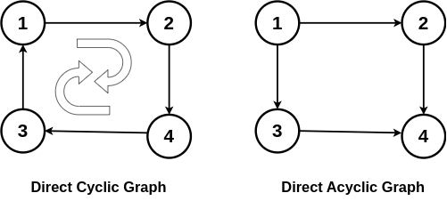
Directed Acyclic Graph (DAG)
A Directed Acyclic Graph (DAG) is a directed graph that does not contain any cycles.
Directed Acyclic Graph has two important features:
Directed Edges: In Directed Acyclic Graph, each edge has a direction, meaning it goes from one vertex (node) to another.
Acyclic: The term "acyclic" indicates that there are no cycles or closed loops within the graph.

Slide 119
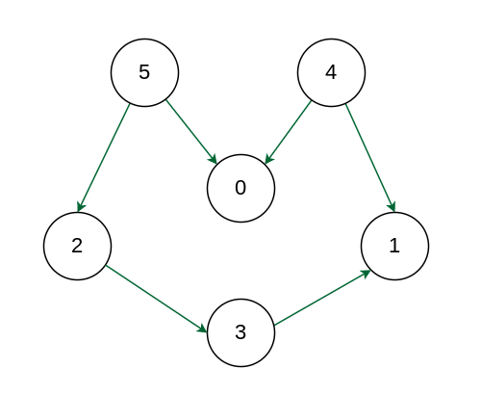
Topological Sorting
A linear ordering of vertices such that for every directed edge (u, v), vertex u comes before v in the ordering.
Only works for Directed Acyclic Graph (DAG).
Here, E = {(2, 3), (3, 1), (4, 0), (4, 1), (5, 0), (5, 2)}
One possible topological sorting is 4 5 2 3 1 0. Among the edges, one of them is (4, 0). As we can see, 4 comes before 0 in the sequence. Same can be said for (3, 1) and others as well.
There can be more than one topological sorting for a graph.

Slide 120
Topological Sorting
Why topological sorting is not possible for graphs with undirected edges?
This creates a contradiction in the topological ordering as an undirected edge (u, v) means there is an edge from u to v as well as from v to u.
1
Here, the edge between nodes 1 and 2 means just they are connected, but there’s no concept of one coming before the other. As such, contradiction will be created in the ordering.
2
3

Slide 121
Topological Sorting
Why topological sorting is not possible for graphs with cycles?
This also creates a contradiction in the topological ordering as in a cycle, all the vertices are indirectly dependent on each other.
1
Here, the vertices (1, 2), (2, 3) and (3, 1) are indirectly dependent on each other. As a result, a topological ordering 1 2 3 contradicts with the edge (3, 1) as here 3 comes before 1.
2
3

Slide 122
Topological Sorting using DFS
Visited
0 | 0 | 0 | 0 | 0
1
3
1 2 3 4 5
Start Time
0 | 0 | 0 | 0 | 0
2
4
5
1 2 3 4 5
End Time
0 | 0 | 0 | 0 | 0
1 2 3 4 5

Slide 123
Topological Sorting using DFS
Visited
1 | 0 | 0 | 0 | 0
1
3
1 2 3 4 5
Start Time
1 | 0 | 0 | 0 | 0
2
4
5
1 2 3 4 5
End Time
0 | 0 | 0 | 0 | 0
1 2 3 4 5

Slide 124
Topological Sorting using DFS
Visited
1 | 1 | 0 | 0 | 0
1
3
1 2 3 4 5
Start Time
1 | 2 | 0 | 0 | 0
2
4
5
1 2 3 4 5
End Time
0 | 0 | 0 | 0 | 0
1 2 3 4 5

Slide 125
Topological Sorting using DFS
Visited
1 | 1 | 1 | 0 | 0
1
3
1 2 3 4 5
Start Time
1 | 2 | 0 | 3 | 0
2
4
5
1 2 3 4 5
End Time
0 | 0 | 0 | 0 | 0
1 2 3 4 5

Slide 126
Topological Sorting using DFS
Visited
1 | 1 | 0 | 1 | 1
1
3
1 2 3 4 5
Start Time
1 | 2 | 0 | 3 | 4
2
4
5
1 2 3 4 5
End Time
0 | 0 | 0 | 0 | 0
1 2 3 4 5

Slide 127
Topological Sorting using DFS
Visited
1 | 0 | 1 | 1 | 1
1
3
1 2 3 4 5
Start Time
1 | 0 | 2 | 3 | 4
2
4
5
1 2 3 4 5
End Time
0 | 0 | 0 | 0 | 5
1 2 3 4 5

Slide 128
Topological Sorting using DFS
Visited
1 | 0 | 1 | 1 | 1
1
3
1 2 3 4 5
Start Time
1 | 0 | 2 | 3 | 4
2
4
5
1 2 3 4 5
End Time
0 | 0 | 0 | 6 | 5
1 2 3 4 5

Slide 129
Topological Sorting using DFS
Visited
1 | 0 | 1 | 1 | 1
1
3
1 2 3 4 5
Start Time
1 | 0 | 2 | 3 | 4
2
4
5
1 2 3 4 5
End Time
0 | 7 | 0 | 6 | 5
1 2 3 4 5

Slide 130
Topological Sorting using DFS
Visited
1 | 0 | 1 | 1 | 1
1
3
1 2 3 4 5
Start Time
1 | 8 | 2 | 3 | 4
2
4
5
1 2 3 4 5
End Time
0 | 7 | 0 | 6 | 5
1 2 3 4 5

Slide 131
Topological Sorting using DFS
Visited
1 | 0 | 1 | 1 | 1
1
3
1 2 3 4 5
Start Time
1 | 8 | 2 | 3 | 4
2
4
5
1 2 3 4 5
End Time
0 | 7 | 9 | 6 | 5
1 2 3 4 5

Slide 132
Topological Sorting using DFS
Visited
1 | 0 | 1 | 1 | 1
1
3
1 2 3 4 5
Start Time
1 | 8 | 2 | 3 | 4
2
4
5
1 2 3 4 5
End Time
10 | 7 | 9 | 6 | 5
1 2 3 4 5

Slide 133
Topological Sorting using DFS
End Time
1
3
10 | 7 | 9 | 6 | 5
1 2 3 4 5
If we sort the ending times based on descending order, we get 10, 9, 7, 6, 5 i.e. vertices 1, 3, 2, 4, 5 which is a topological ordering for the above graph.
2
4
5

Slide 134
Topological Sorting using BFS
Also known as Kahn’s Algorithm for Topological Sorting.
Indegree
6
1
5
2 | 2 | 1 | 1 | 0 | 0
1 2 3 4 5 6
3
4
2
Queue
Topological Ordering:

Slide 135
Topological Sorting using BFS
Initially, enqueue all the nodes with indegree 0 into the queue i.e. 5 and 6 in this case.
Indegree
6
1
5
2 | 2 | 1 | 1 | 0 | 0
1 2 3 4 5 6
3
4
2
5 6
Queue
Topological Ordering:

Slide 136
Topological Sorting using BFS
Dequeue from the front of the queue i.e. 5 in this case.
Indegree
6
1
5
2 | 2 | 1 | 1 | 0 | 0
1 2 3 4 5 6
3
4
2
6
Queue
Topological Ordering:

Slide 137
Topological Sorting using BFS
Now, enqueue from the front of the queue i.e. 5 in this case.
Indegree
6
1
5
2 | 2 | 1 | 1 | 0 | 0
1 2 3 4 5 6
3
4
2
6
Queue
Topological Ordering:

Slide 138
Topological Sorting using BFS
Now, reduce the indegree of the adjacent vertices of 5 i.e. 1 and 2.
Indegree
6
1
5
1 | 1 | 1 | 1 | 0 | 0
1 2 3 4 5 6
3
4
2
6
Queue
Topological Ordering: 5

Slide 139
Topological Sorting using BFS
Next, remove from the front of the queue i.e. 6 in this case.
Indegree
6
1
5
1 | 1 | 1 | 1 | 0 | 0
1 2 3 4 5 6
3
4
2
Queue
Topological Ordering: 5

Slide 140
Topological Sorting using BFS
Now, reduce the indegree of the adjacent vertices of 6 i.e. 1 and 3.
Indegree
6
1
5
0 | 1 | 0 | 1 | 0 | 0
1 2 3 4 5 6
3
4
2
Queue
Topological Ordering: 5 6

Slide 141
Topological Sorting using BFS
Indegree of vertices 1 and 3 is 0 now. Therefore, insert them into the queue.
Indegree
6
1
5
0 | 1 | 0 | 1 | 0 | 0
1 2 3 4 5 6
3
4
2
1 3
Queue
Topological Ordering: 5 6

Slide 142
Topological Sorting using BFS
Remove from the front of queue i.e. 1. Now, 1 does not have any outgoing edges so go to next step and write 1 in the ordering.
Indegree
6
1
5
0 | 1 | 0 | 1 | 0 | 0
1 2 3 4 5 6
3
4
2
3
Queue
Topological Ordering: 5 6 1

Slide 143
Topological Sorting using BFS
Again, remove from the front of queue i.e. 3.
Indegree
6
1
5
0 | 1 | 0 | 1 | 0 | 0
1 2 3 4 5 6
3
4
2
Queue
Topological Ordering: 5 6 1

Slide 144
Topological Sorting using BFS
Reduce the indegree of adjacent vertices of 3 i.e. 4 in this case.
Indegree
6
1
5
0 | 1 | 0 | 0 | 0 | 0
1 2 3 4 5 6
3
4
2
Queue
Topological Ordering: 5 6 1 3

Slide 145
Topological Sorting using BFS
Indegree of vertex 4 is 0 now. Enqueue it into the queue.
Indegree
6
1
5
0 | 1 | 0 | 0 | 0 | 0
1 2 3 4 5 6
3
4
2
4
Queue
Topological Ordering: 5 6 1 3

Slide 146
Topological Sorting using BFS
Dequeue from the queue i.e. 4. Reduce the indegree of adjacent vertices of 4 i.e. 2.
Indegree
6
1
5
0 | 0 | 0 | 0 | 0 | 0
1 2 3 4 5 6
3
4
2
Queue
Topological Ordering: 5 6 1 3 4

Slide 147
Topological Sorting using BFS
Enqueue 2 into the queue has it has indegree 0.
Indegree
6
1
5
0 | 0 | 0 | 0 | 0 | 0
1 2 3 4 5 6
3
4
2
2
Queue
Topological Ordering: 5 6 1 3 4

Slide 148
Topological Sorting using BFS
Dequeue from the front of queue, and since 2 has no adjacent vertices, write it in the ordering. 5 6 1 3 4 2 is topological sorting for the graph.
Indegree
6
1
5
0 | 0 | 0 | 0 | 0 | 0
1 2 3 4 5 6
3
4
2
Queue
Topological Ordering: 5 6 1 3 4 2

Slide 149
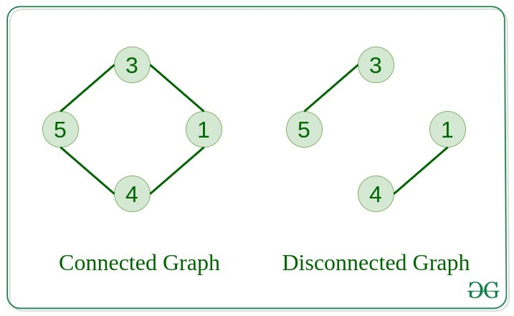
Connected Components

Slide 150
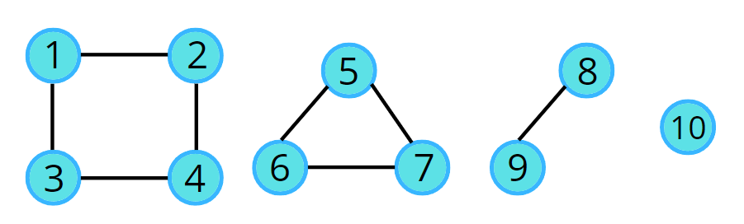
Connected Components

Slide 151
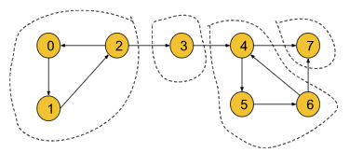
Strongly Connected Components
A component is called a Strongly Connected Component(SCC) only if for every possible pair of vertices (u, v) inside that component, u is reachable from v and v is reachable from u.
In this graph, [0, 1, 2] is a strongly connected component. Here, we can reach from 0 to 1 and vice versa, 1 to 2 and vice versa and 2 to 0 and vice versa.

Slide 152
Strongly Connected Components
Similarly, in this graph, there are 4 strongly connected components, [0, 1, 2], [3], [4, 5, 6] and 7.

Slide 153
Kosaraju’s Algorithm
Initially, transpose the given graph i.e. edge (u, v) becomes (v, u).
1
5
6
1
5
6
0
2
3
4
7
0
2
3
4
7

Slide 154
Kosaraju’s Algorithm
Run DFS on the initial graph from the source vertex.
1
5
6
1
5
6
0
2
3
4
7
0
2
3
4
7
Visited
Visited
0 | 0 | 0 | 0 | 0 | 0 | 0 | 0
0 | 0 | 0 | 0 | 0 | 0 | 0 | 0
0 1 2 3 4 5 6 7
0 1 2 3 4 5 6 7
Stack
Reference Stack

Slide 155
Kosaraju’s Algorithm
Run DFS on the initial graph from the source vertex.
1
5
6
1
5
6
0
2
3
4
7
0
2
3
4
7
Visited
Visited
1 | 0 | 0 | 0 | 0 | 0 | 0 | 0
0 | 0 | 0 | 0 | 0 | 0 | 0 | 0
0 1 2 3 4 5 6 7
0 1 2 3 4 5 6 7
0
Stack
Reference Stack

Slide 156
Kosaraju’s Algorithm
Run DFS on the initial graph from the source vertex.
1
5
6
1
5
6
0
2
3
4
7
0
2
3
4
7
Visited
Visited
1 | 1 | 0 | 0 | 0 | 0 | 0 | 0
0 | 0 | 0 | 0 | 0 | 0 | 0 | 0
0 1 2 3 4 5 6 7
0 1 2 3 4 5 6 7
0 1
Stack
Reference Stack

Slide 157
Kosaraju’s Algorithm
Run DFS on the initial graph from the source vertex.
1
5
6
1
5
6
0
2
3
4
7
0
2
3
4
7
Visited
Visited
1 | 1 | 1 | 0 | 0 | 0 | 0 | 0
0 | 0 | 0 | 0 | 0 | 0 | 0 | 0
0 1 2 3 4 5 6 7
0 1 2 3 4 5 6 7
0 1 2
Stack
Reference Stack

Slide 158
Kosaraju’s Algorithm
Run DFS on the initial graph from the source vertex.
1
5
6
1
5
6
0
2
3
4
7
0
2
3
4
7
Visited
Visited
1 | 1 | 1 | 1 | 0 | 0 | 0 | 0
0 | 0 | 0 | 0 | 0 | 0 | 0 | 0
0 1 2 3 4 5 6 7
0 1 2 3 4 5 6 7
0 1 2 3
Stack
Reference Stack

Slide 159
Kosaraju’s Algorithm
Run DFS on the initial graph from the source vertex.
1
5
6
1
5
6
0
2
3
4
7
0
2
3
4
7
Visited
Visited
1 | 1 | 1 | 1 | 1 | 0 | 0 | 0
0 | 0 | 0 | 0 | 0 | 0 | 0 | 0
0 1 2 3 4 5 6 7
0 1 2 3 4 5 6 7
0 1 2 3 4
Stack
Reference Stack

Slide 160
Kosaraju’s Algorithm
Run DFS on the initial graph from the source vertex.
1
5
6
1
5
6
0
2
3
4
7
0
2
3
4
7
Visited
Visited
1 | 1 | 1 | 1 | 1 | 1 | 0 | 0
0 | 0 | 0 | 0 | 0 | 0 | 0 | 0
0 1 2 3 4 5 6 7
0 1 2 3 4 5 6 7
0 1 2 3 4 5
Stack
Reference Stack

Slide 161
Kosaraju’s Algorithm
Run DFS on the initial graph from the source vertex.
1
5
6
1
5
6
0
2
3
4
7
0
2
3
4
7
Visited
Visited
1 | 1 | 1 | 1 | 1 | 1 | 1 | 1
0 | 0 | 0 | 0 | 0 | 0 | 0 | 0
0 1 2 3 4 5 6 7
0 1 2 3 4 5 6 7
0 1 2 3 4 5 6 7
Stack
Reference Stack

Slide 162
Kosaraju’s Algorithm
Pop all the vertices from the stack and push them into the reference stack.
1
5
6
1
5
6
0
2
3
4
7
0
2
3
4
7
Visited
Visited
1 | 1 | 1 | 1 | 1 | 1 | 1 | 1
0 | 0 | 0 | 0 | 0 | 0 | 0 | 0
0 1 2 3 4 5 6 7
0 1 2 3 4 5 6 7
0 1 2 3 4 5 6
7
Stack
Reference Stack

Slide 163
Kosaraju’s Algorithm
Pop all the vertices from the stack and push them into the reference stack.
1
5
6
1
5
6
0
2
3
4
7
0
2
3
4
7
Visited
Visited
1 | 1 | 1 | 1 | 1 | 1 | 1 | 1
0 | 0 | 0 | 0 | 0 | 0 | 0 | 0
0 1 2 3 4 5 6 7
0 1 2 3 4 5 6 7
0 1 2 3 4 5
7 6
Stack
Reference Stack

Slide 164
Kosaraju’s Algorithm
Pop all the vertices from the stack and push them into the reference stack.
1
5
6
1
5
6
0
2
3
4
7
0
2
3
4
7
Visited
Visited
1 | 1 | 1 | 1 | 1 | 1 | 1 | 1
0 | 0 | 0 | 0 | 0 | 0 | 0 | 0
0 1 2 3 4 5 6 7
0 1 2 3 4 5 6 7
0 1 2 3 4
7 6 5
Stack
Reference Stack

Slide 165
Kosaraju’s Algorithm
Pop all the vertices from the stack and push them into the reference stack.
1
5
6
1
5
6
0
2
3
4
7
0
2
3
4
7
Visited
Visited
1 | 1 | 1 | 1 | 1 | 1 | 1 | 1
0 | 0 | 0 | 0 | 0 | 0 | 0 | 0
0 1 2 3 4 5 6 7
0 1 2 3 4 5 6 7
0 1 2 3
7 6 5 4
Stack
Reference Stack

Slide 166
Kosaraju’s Algorithm
Pop all the vertices from the stack and push them into the reference stack.
1
5
6
1
5
6
0
2
3
4
7
0
2
3
4
7
Visited
Visited
1 | 1 | 1 | 1 | 1 | 1 | 1 | 1
0 | 0 | 0 | 0 | 0 | 0 | 0 | 0
0 1 2 3 4 5 6 7
0 1 2 3 4 5 6 7
0 1 2
7 6 5 4 3
Stack
Reference Stack

Slide 167
Kosaraju’s Algorithm
Pop all the vertices from the stack and push them into the reference stack.
1
5
6
1
5
6
0
2
3
4
7
0
2
3
4
7
Visited
Visited
1 | 1 | 1 | 1 | 1 | 1 | 1 | 1
0 | 0 | 0 | 0 | 0 | 0 | 0 | 0
0 1 2 3 4 5 6 7
0 1 2 3 4 5 6 7
0 1
7 6 5 4 3 2
Stack
Reference Stack

Slide 168
Kosaraju’s Algorithm
Pop all the vertices from the stack and push them into the reference stack.
1
5
6
1
5
6
0
2
3
4
7
0
2
3
4
7
Visited
Visited
1 | 1 | 1 | 1 | 1 | 1 | 1 | 1
0 | 0 | 0 | 0 | 0 | 0 | 0 | 0
0 1 2 3 4 5 6 7
0 1 2 3 4 5 6 7
0
7 6 5 4 3 2 1
Stack
Reference Stack

Slide 169
Kosaraju’s Algorithm
Pop all the vertices from the stack and push them into the reference stack.
1
5
6
1
5
6
0
2
3
4
7
0
2
3
4
7
Visited
Visited
1 | 1 | 1 | 1 | 1 | 1 | 1 | 1
0 | 0 | 0 | 0 | 0 | 0 | 0 | 0
0 1 2 3 4 5 6 7
0 1 2 3 4 5 6 7
7 6 5 4 3 2 1 0
Stack
Reference Stack

Slide 170
Kosaraju’s Algorithm
Pop the vertex from the stack i.e. 0 in this case and run DFS starting from 0.
1
5
6
0
2
3
4
7
Visited
0 | 0 | 0 | 0 | 0 | 0 | 0 | 0
0 1 2 3 4 5 6 7
7 6 5 4 3 2 1 0
Reference Stack

Slide 171
Kosaraju’s Algorithm
1
5
6
DFS(0)
0
2
3
4
7
Visited
1 | 0 | 0 | 0 | 0 | 0 | 0 | 0
0 1 2 3 4 5 6 7
7 6 5 4 3 2 1
Reference Stack

Slide 172
Kosaraju’s Algorithm
1
5
6
DFS(0) -> DFS(2)
0
2
3
4
7
Visited
1 | 0 | 1 | 0 | 0 | 0 | 0 | 0
0 1 2 3 4 5 6 7
7 6 5 4 3 2 1
Reference Stack

Slide 173
Kosaraju’s Algorithm
1
5
6
DFS(0) -> DFS(2) -> DFS(1)
0
2
3
4
7
Visited
1 | 1 | 1 | 0 | 0 | 0 | 0 | 0
0 1 2 3 4 5 6 7
7 6 5 4 3 2 1
Reference Stack

Slide 174
Kosaraju’s Algorithm
1
5
6
DFS(0) -> DFS(2) -> DFS(1)
Now, from 1 we can go to 0 however it is already visited. Since there are no unvisited vertex, we’ll backtrack to 2 and from 2, we’ll backtrack to 0. Therefore, [0, 2, 1] is our first SCC.
0
2
3
4
7
Visited
1 | 1 | 1 | 0 | 0 | 0 | 0 | 0
0 1 2 3 4 5 6 7
7 6 5 4 3 2 1
Reference Stack

Slide 175
Kosaraju’s Algorithm
Pop the vertex from the stack i.e. 1 in this case. However, 1 is already visited.
1
5
6
0
2
3
4
7
Visited
1 | 1 | 1 | 0 | 0 | 0 | 0 | 0
0 1 2 3 4 5 6 7
7 6 5 4 3 2
Reference Stack

Slide 176
Kosaraju’s Algorithm
Pop the vertex from the stack i.e. 2 in this case. However, 2 is already visited.
1
5
6
0
2
3
4
7
Visited
1 | 1 | 1 | 0 | 0 | 0 | 0 | 0
0 1 2 3 4 5 6 7
7 6 5 4 3
Reference Stack

Slide 177
Kosaraju’s Algorithm
Pop the vertex from the stack i.e. 3 in this case. Run DFS from 3.
1
5
6
DFS(3) From 3, we can go to 1. However, 1 is already visited. As we don’t have any other adjacent vertices, 3 is our second SCC.
0
2
3
4
7
Visited
1 | 1 | 1 | 1 | 0 | 0 | 0 | 0
0 1 2 3 4 5 6 7
7 6 5 4
Reference Stack

Slide 178
Kosaraju’s Algorithm
Pop the vertex from the stack i.e. 4 in this case. Run DFS from 4.
1
5
6
DFS(4)
0
2
3
4
7
Visited
1 | 1 | 1 | 1 | 1 | 0 | 0 | 0
0 1 2 3 4 5 6 7
7 6 5
Reference Stack

Slide 179
Kosaraju’s Algorithm
1
5
6
DFS(4) -> DFS(6)
0
2
3
4
7
Visited
1 | 1 | 1 | 1 | 1 | 0 | 1 | 0
0 1 2 3 4 5 6 7
7 6 5
Reference Stack

Slide 180
Kosaraju’s Algorithm
1
5
6
DFS(4) -> DFS(6) -> DFS(5)
0
2
3
4
7
Visited
1 | 1 | 1 | 1 | 1 | 1 | 1 | 0
0 1 2 3 4 5 6 7
7 6 5
Reference Stack

Slide 181
Kosaraju’s Algorithm
1
5
6
DFS(4) -> DFS(6) -> DFS(5)
From 5 we can go to 4. However, it is already visited. So, we’ll backtrack from 5 to 6, and then 6 to 4. Since 4 doesn’t any adjacent vertices, therefore, [4, 6, 5] is our third SCC.
0
2
3
4
7
Visited
1 | 1 | 1 | 1 | 1 | 1 | 1 | 0
0 1 2 3 4 5 6 7
7 6 5
Reference Stack

Slide 182
Kosaraju’s Algorithm
Pop the vertex from the stack i.e. 5 in this case. However, 5 is already visited.
1
5
6
0
2
3
4
7
Visited
1 | 1 | 1 | 1 | 1 | 1 | 1 | 0
0 1 2 3 4 5 6 7
7 6
Reference Stack

Slide 183
Kosaraju’s Algorithm
Pop the vertex from the stack i.e. 6 in this case. However, 6 is already visited.
1
5
6
0
2
3
4
7
Visited
1 | 1 | 1 | 1 | 1 | 1 | 1 | 0
0 1 2 3 4 5 6 7
7
Reference Stack

Slide 184
Kosaraju’s Algorithm
Pop the vertex from the stack i.e. 7 in this case. Run DFS from 7.
1
5
6
DFS(7)
0
2
3
4
7
Visited
1 | 1 | 1 | 1 | 1 | 1 | 1 | 1
0 1 2 3 4 5 6 7
Reference Stack

Slide 185
Kosaraju’s Algorithm
Pop the vertex from the stack i.e. 7 in this case. Run DFS from 7.
5
6
DFS(7)
7 has two adjacent vertices 4 and 6, however, both are already visited. Therefore, 7 is our fourth SCC.
[0, 2, 1]: SCC1
[3]: SCC2
[4, 6, 5]: SCC3
[7]: SCC4
This is Kosaraju’s Algorithm!
1
0
2
3
4
7
Visited
1 | 1 | 1 | 1 | 1 | 1 | 1 | 1
0 1 2 3 4 5 6 7
Reference Stack

Slide 186
References
Mumit sir’s slide - https://drive.google.com/file/d/1OkLO91GV4M23e-1EtvFr9yeGWgk6V91q/view
PNP sir’s slide - https://docs.google.com/presentation/d/1bKKT_3Mnlp0cV509k7E8hBWEKQ_YfV0cfek10LDCo6Y/edit?slide=id.g26e6291b7d8_0_183#slide=id.g26e6291b7d8_0_183

